Slide 1

SKYFLY TOURS WEBSITE
BY,
ANANYA - 121320044003
ROOPA- 121320044056
BSC. MSCS

Slide 2
INTRODUCTION
We are an online travel agency providing exceptional travel experiences. We offer a wide range of tour packages, and we hope to include flight bookings and hotel reservations.
Traveling is more than just moving from one place to another. It's about exploring new places, immersing yourself in different cultures, and creating unforgettable memories. So, we offer a variety of travel packages that fit into your budget.
You can also browse through our comprehensive list of tour packages and customize them to meet your specific needs.

Slide 3
ABSTRACT
Our platform provides a variety of tours ranging from cultural sightseeing to adventure activities.
With SkyFly, travelers can explore different states, learn about their cultures and traditions, and create unforgettable memories.
We are committed to providing exceptional customer service, ensuring that travelers have a seamless and stress-free travel experience.

Slide 4
OBJECTIVE
The objective of SkyFly is to provide travelers with a seamless and stress-free travel experience.
We strive to create unique and personalized travel experiences that cater to the needs and preferences of our clients.
Our goal is to bring a smile on our customer’s face as they mark the end of their fun-filled adventure.

Slide 5
PURPOSE
Our purpose is to provide travelers with a one-stop-shop for all their travel needs.
SkyFly travelers can browse through a vast selection of tours, select their preferred travel dates and destinations, and make secure online bookings with confidence.
We have an easy- to-use platform for travelers providing them a hassle-free and unforgettable travel experience.

Slide 6
SCOPE
We cater to the needs of all types of travelers, including solo travelers, families, couples, and groups.
We plan to include flight and hotel bookings in our upcoming versions.
Also, we would like to add foreign tours in our model.

Slide 7
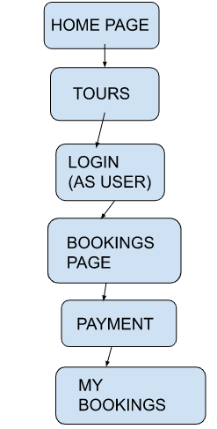
USE CASE DIAGRAM (FOR USER)

Slide 8
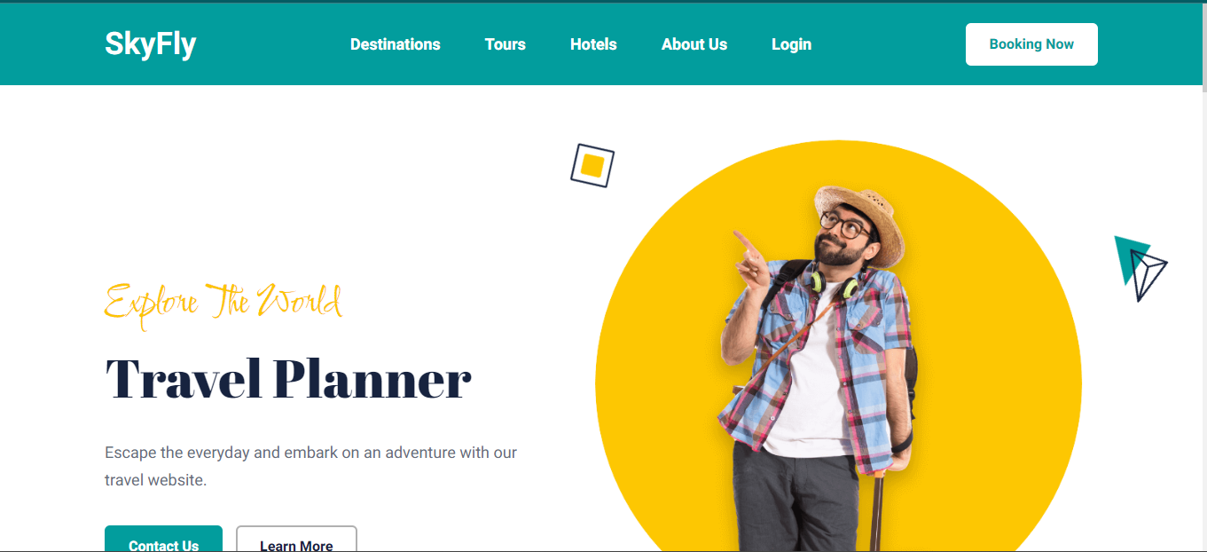

Slide 9
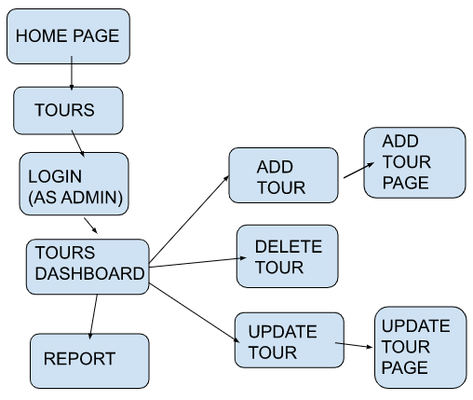
USE CASE DIAGRAM (FOR ADMIN)

Slide 10
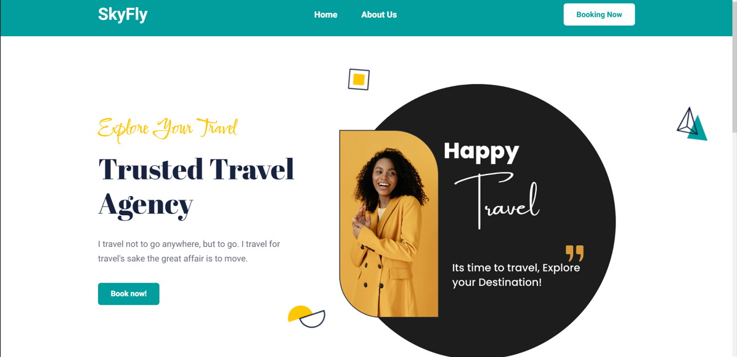

Slide 11
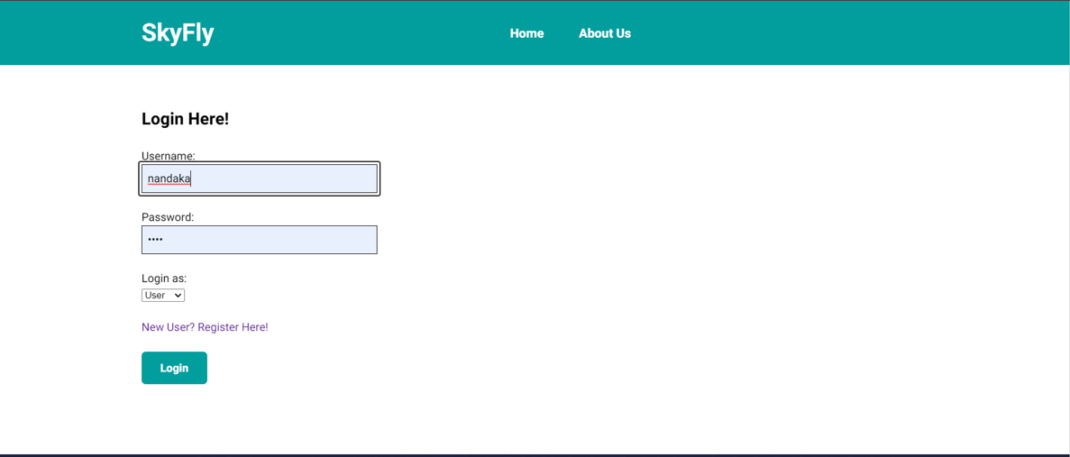

Slide 12
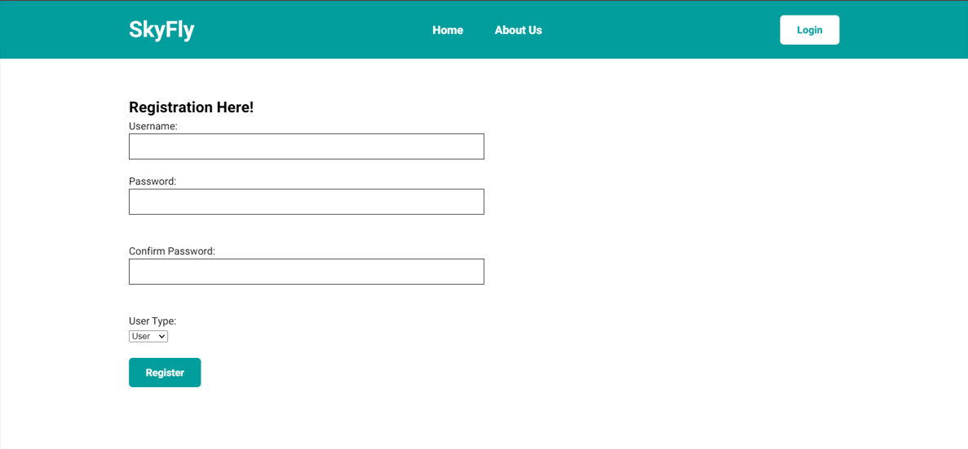

Slide 13
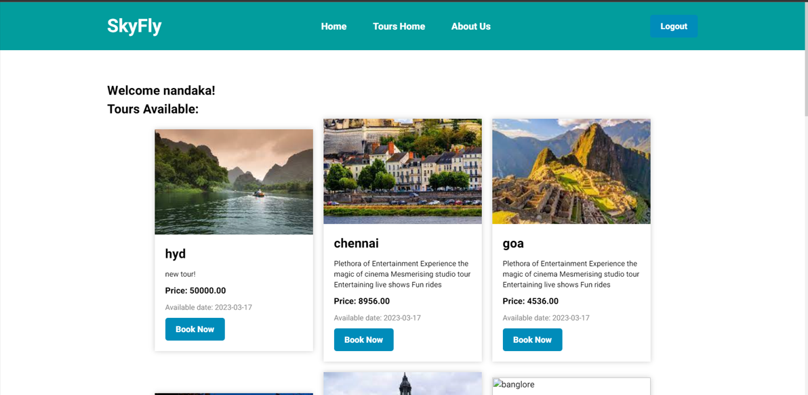

Slide 14
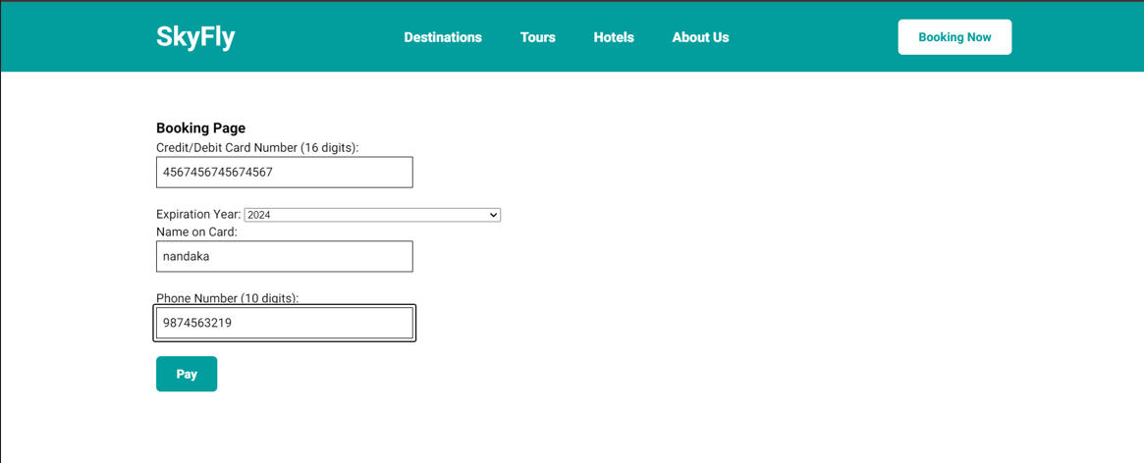

Slide 15
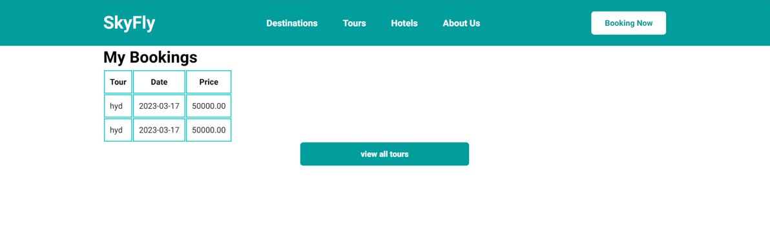

Slide 16
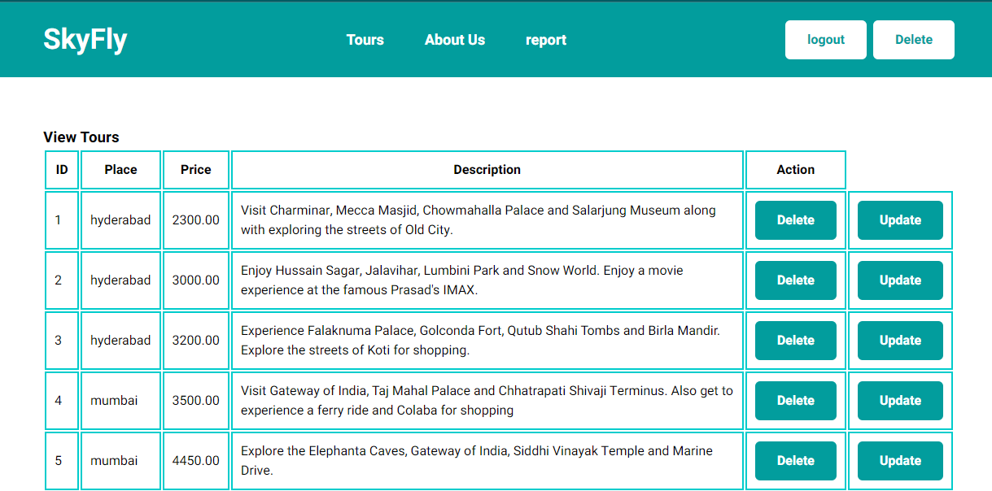

Slide 17
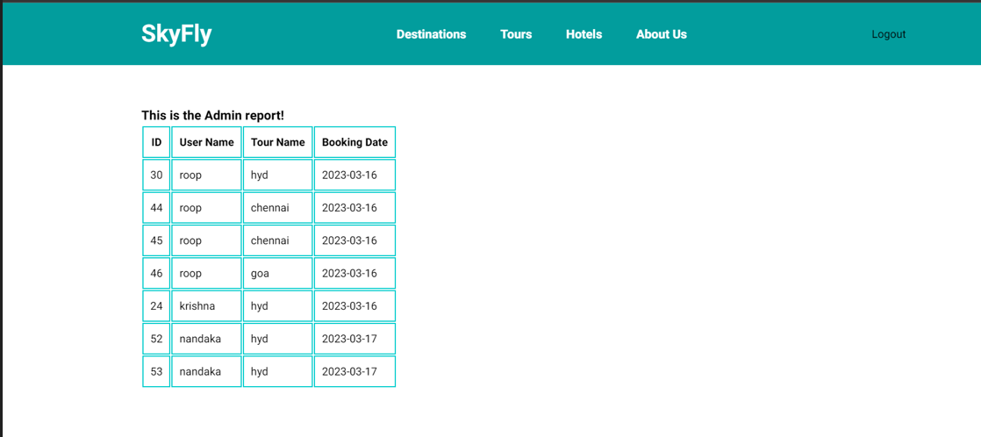

Slide 18
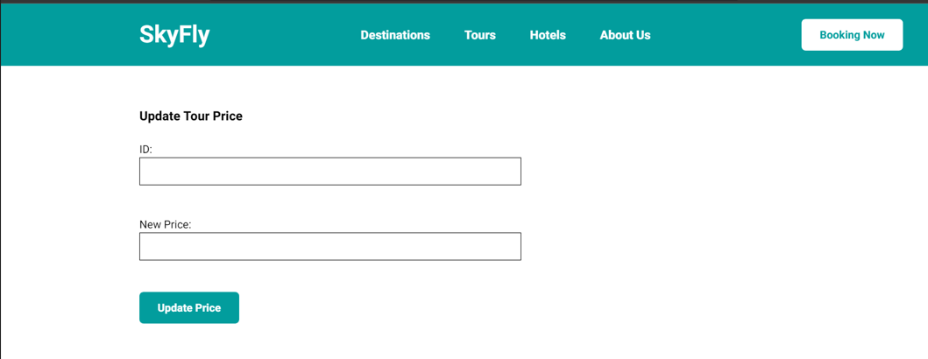

Slide 19
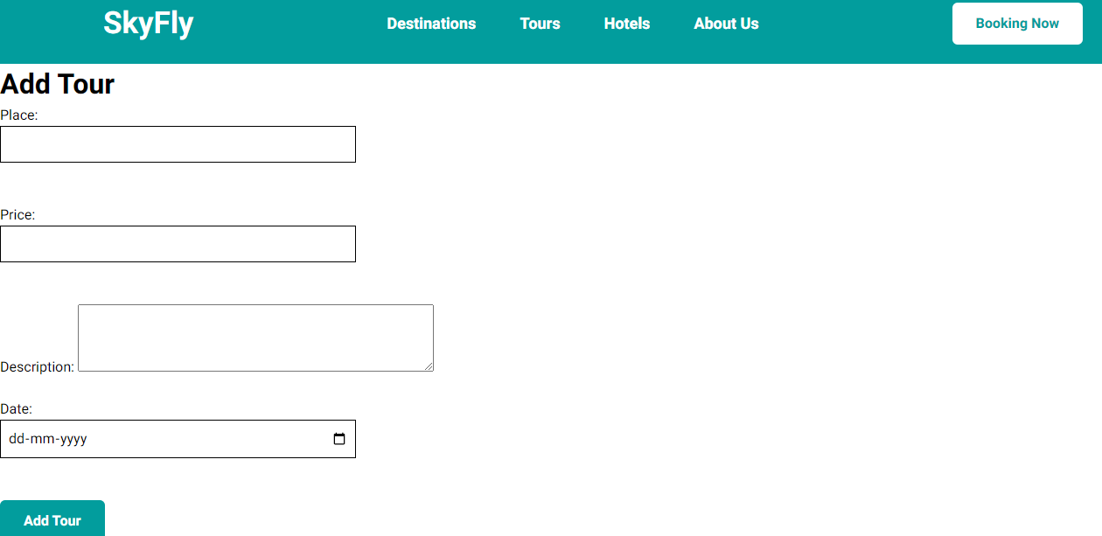

Slide 20
CONCLUSION
Our website is designed with user experience in mind with an interface that is easy to navigate.
The project has been developed using HTML, CSS, PHP, and MySQL database management system technologies .
In conclusion, SkyFly designed to meet the travel needs of individuals and groups.

Slide 21

Thank you for choosing SkyFly.
We look forward to helping you plan your next adventure!

